Slide 1
A Seminar on ClearNav, a pothole alert navigation application
Team Details:
K. Sai Ganesh (20EG105626)
D. Ajay Chowdhary (20EG105646)
M. Sai Vivek (20EG105632)
Project Supervisor
Dr. A. Jyothi

Slide 2
Introduction
ClearNav, an innovative app, redefines the driving experience through crowd-sourced data on road imperfections.
Users play a pivotal role by effortlessly uploading the locations of potholes and deteriorating roads.
The app establishes a comprehensive real-time navigation database, prioritizing user-generated reports for effective issue resolution.
ClearNav's integrated real-time navigation aid ensures users receive alerts about reported road problems and suggests alternative routes.
The app's community-driven approach fosters active user engagement, contributing to a dynamic database for continuous road safety improvement.
ClearNav stands as a collaborative solution, not just an app, shaping the future of road safety and elevating the driving experience.

Slide 3
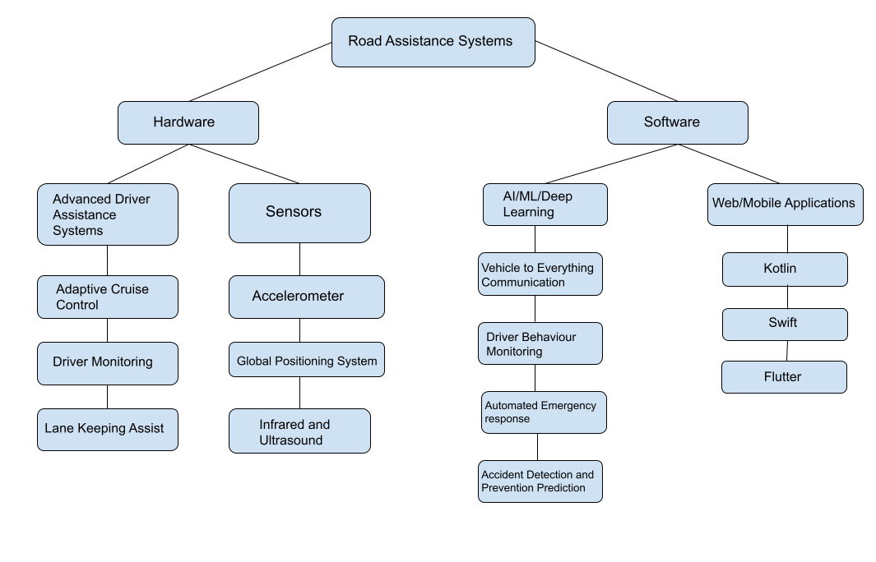
Concept Tree

Slide 4
Literature
Sno | Method | Advantages | Disadvantages
1. | Advanced Driver Assistance Systems | Can reduce the likelihood of accidents and improve overall road safety. | ADAS technologies can increase the cost of vehicles.
2. | Automated Emergency Braking | Automatically applies brakes in emergency situations, reducing the severity of collisions. | Limited by the vehicle's speed and sensor capabilities.
3. | Intelligent Speed Assistance | Helps prevent speeding-related accidents by alerting or limiting vehicle speed. | Relies on accurate mapping and real-time traffic sign recognition.
4. | Vehicle-to-Everything (V2X) Communication | Facilitates communication between vehicles and infrastructure, sharing real-time data for enhanced safety. | Privacy and security concerns need to be addressed.
5. | Warning Signs | Can warn the drivers prior road problems. | Signs may not be made immediately.
6. | Roadside Crash Barriers | Mitigates the severity of accidents by preventing vehicles from leaving the road. | Installation and maintenance costs can be high.

Slide 5
Literature
Author(s) | Strategies | Advantages | Disadvantages
Nor Amanina Binti Zamri, Nik Sakinah Binti Nik Ab Aziz | Road Assist Mobile Application System,2022 | Informs drivers’ insurance providers when having car breakdown issue. | Cannot guarantee immediate response.
Shubhranshu Barnwal | Vehicle Behavior Analysis for Uneven Road Surface Detection, 2020 | Uneven road surfaces are identified from specific motion patterns which are described using a Hidden Markov Model based trajectory classification model. | Doesn’t alert the drivers prior i.e. unless entering the uneven roads or encountering potholes.
Sahel Bej, Swarnava Roy | SmartPave,an IoT-based pothole- tracking system, 2023 | Deep learning and IoT based, uses ultrasonic sensors, can alert the drivers prior to the uneven roads. | Practicality, installation and cost considerations.
A.K.M. Jobayer Al Masud | Pothole detection using Machine Learning, 2021 | Can detect road imbalances and damages caused by them by alerting the drivers about them. | Quite difficult to implement in existing transportation without any displays/smart devices.

Slide 6
Problem Statement
Current methods lack efficiency in providing timely information on road conditions, leaving drivers vulnerable to hazards. ClearNav seeks to overcome this limitation by leveraging user-generated data to create a dynamic map of road conditions for enhanced safety and navigation.
Disadvantages: The inadequacy of existing approaches to deliver timely information on road quality poses a significant disadvantage to drivers, often leading to unforeseen challenges and jeopardizing safety. ClearNav addresses this gap by employing a community-driven model to promptly capture and share real-time road hazard data.

Slide 7
Problem Illustration
Road safety is a significant concern, with a specific focus on addressing the challenges posed by uneven roads and potholes.
Existing technological solutions in road safety primarily concentrate on in-car safety, traffic management, and navigation.
Uneven road surfaces, particularly potholes, contribute to vehicular damage and pose risks to both drivers and pedestrians.
There is a noticeable gap in dedicated technologies aimed at detecting, reporting, and addressing the specific challenges posed by uneven roads.
The absence of such technologies increases the vulnerability of road users and hampers overall road safety efforts.
Innovative solutions tailored to identify and mitigate the impact of uneven roads are essential for enhancing transportation safety.
A community-driven approach involving active participation in reporting and addressing road hazards can contribute to a safer road environment.
Integration of these technologies with navigation systems could provide real-time information and alternative routes for drivers, improving overall awareness.

Slide 8
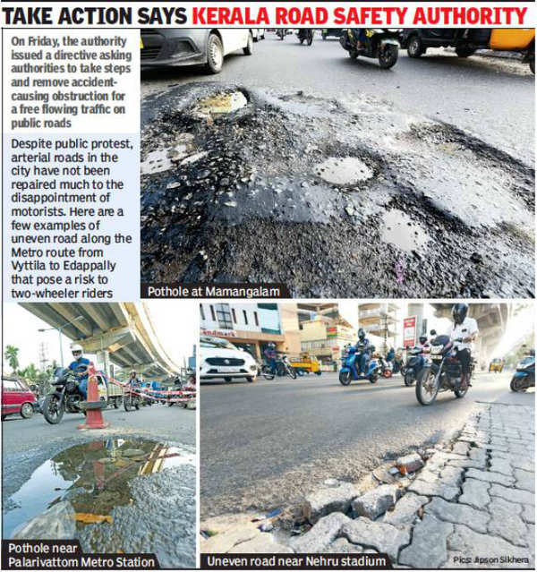
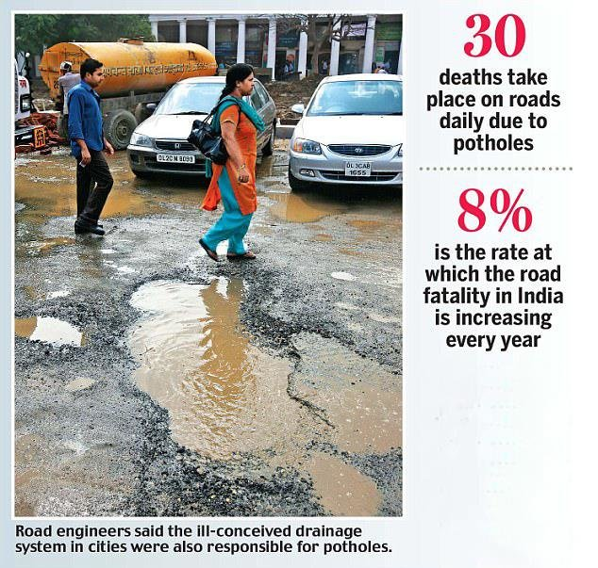
Problem Illustration

Slide 9
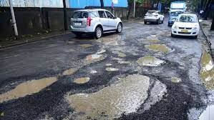
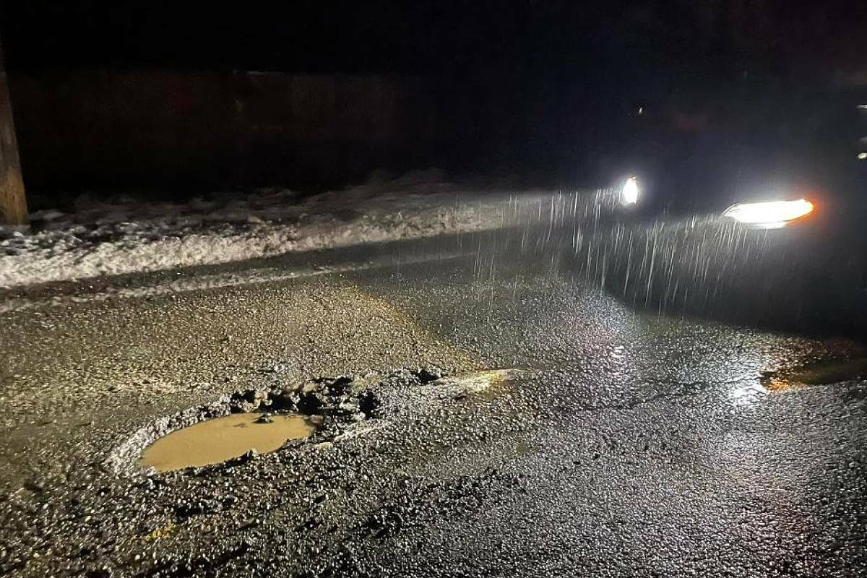
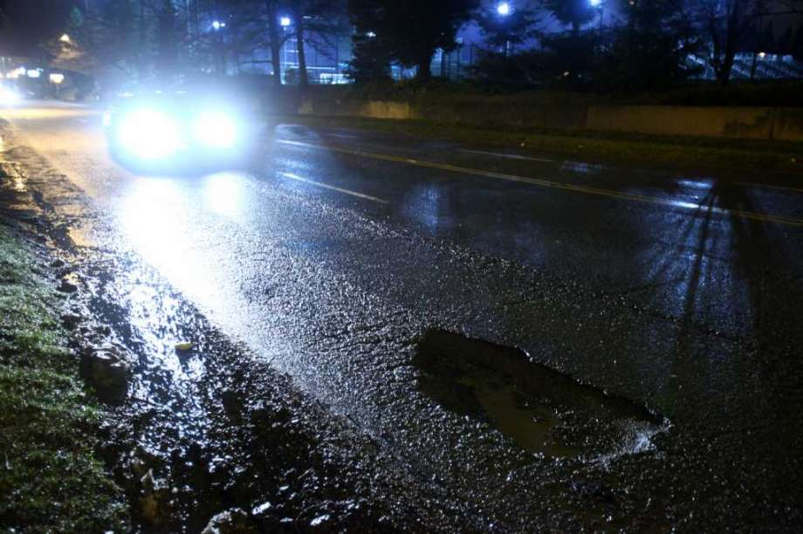
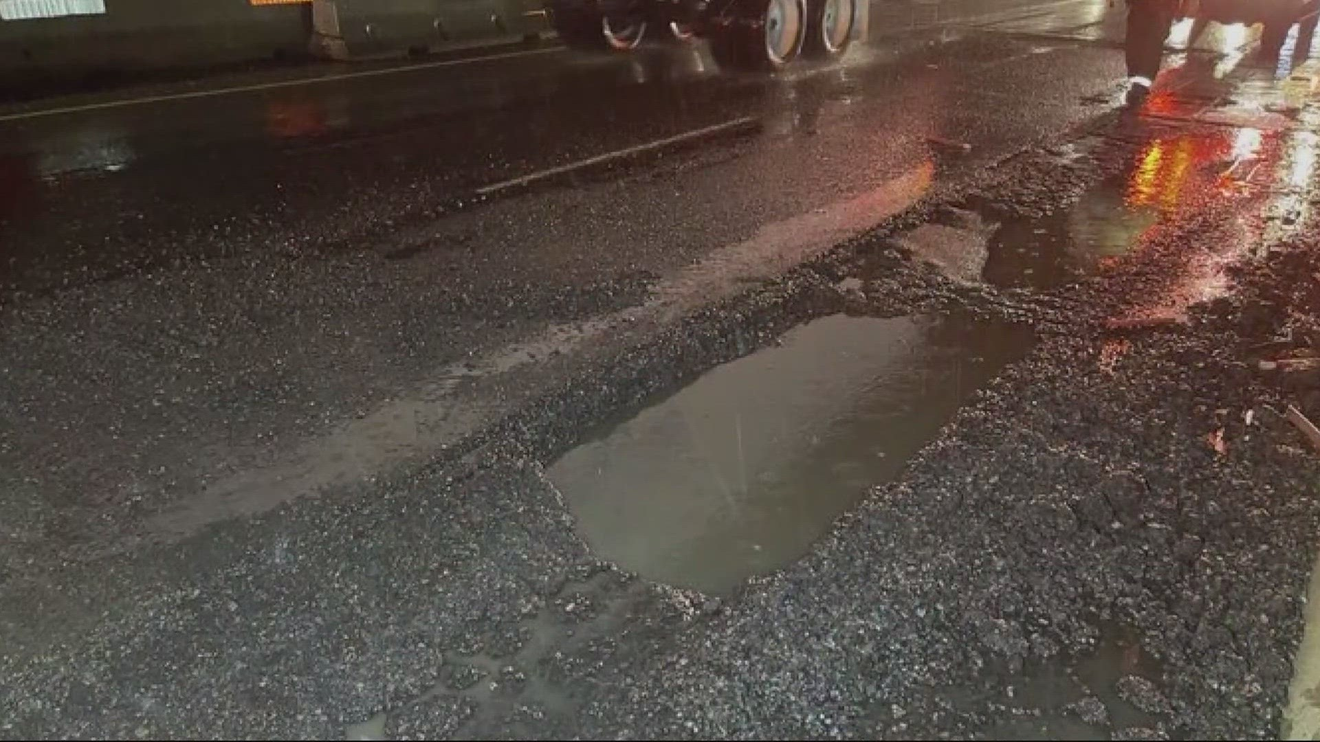
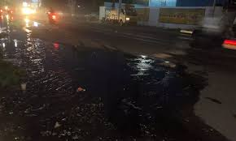
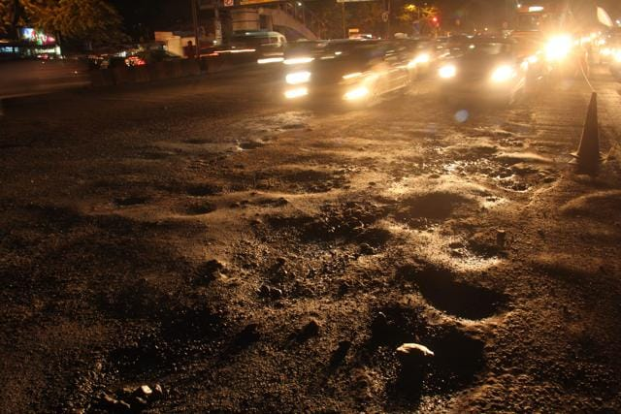
Problem Illustration

Slide 10
Proposed Method
An application with Google maps like interface, allowing easy navigation and reporting of road imperfections.
Users will be able to point, mark on the map, give description, set the severity and submit the report of the road hazard.
The uploaded data will be saved in database.
Integrate GPS for real-time issue location capture.
Whenever a user navigates to the reported area, will be alerted prior entering the area, thereby letting them slowing down the vehicle to avoid any injuries or vehicular damages.

Slide 11
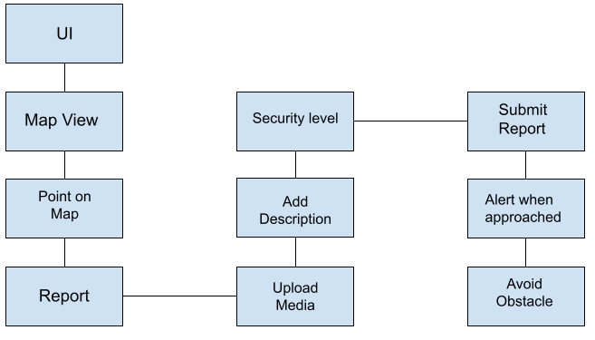
Proposed Method

Slide 12
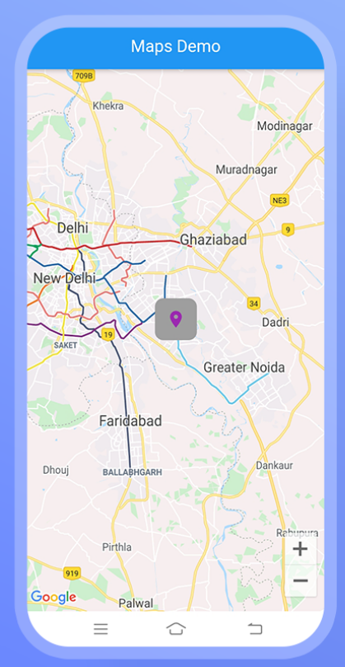
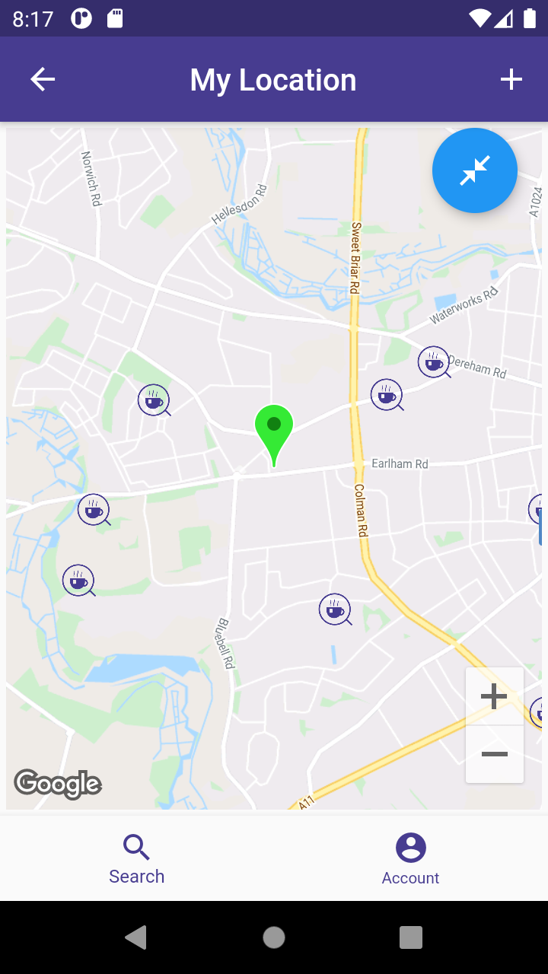
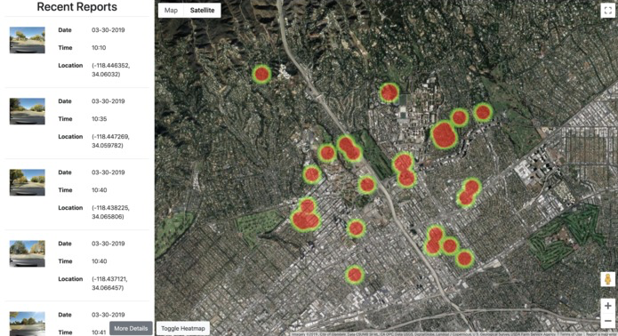
Proposed Method Illustration

Slide 13
Parameters
Pothole Severity Index (PSI):
PSI= (No. of Reports*Average User Rating) / Road Segment Length
Efficiency Index for Repairs(EIR):
EIR= (No. of closed reports / Total No. of Reports)*100
Average Response Time(ART):
ART= Total time taken to close reports / No. of closed Reports

Slide 14







Experiment Environment
Programming Language: Dart
Application Development Toolkit: Flutter
APIs: GoogleMaps API
Platform: Android
IDE: Visual Studio Code, Android Studio
Database: Firebase

Slide 15
Project status
S.No | Functionality | Status
1 | Abstract | Completed
2 | Requirements | Completed
3 | Documentation | Not yet started
4 | Implementation | In Progress

Slide 16
References
[1]. Nor Amanina Binti Zamri, Nik Sakinah Binti Nik Ab Aziz – “Road Assist Mobile Application System (Road Assist)”, 2022
DOI: 10.1109/ICDCECE53908.2022.9793033
[2]. M.A.D. Wickrama, D. S. C. Dharmakeerthi, S. A. Balasooriya – “Mobile Based Solution for Vehicle Assistance”, 2022
DOI: 10.1109/ICAC54203.2021.9671196
[3]. Sahel Bej, Swarnava Roy, Debjit Daw – “SmartPave: An Advanced IoT-Based System for Real-
Time Pothole Detection”, Tracking, and Maintenance, 2023
DOI: 10.1109/APSIT58554.2023.10201720
[4]. A.K.M. Jobayer Al Masud, Saraban Tasnim Sharin, Khandokar Farhan Tanvir Shawon – “Pothole Detection Using Machine Learning Algorithms”, 2021
DOI: 10.1109/ICSPCS53099.2021.9660216

Slide 17
Thank you

Slide 18
Project seminar–I Evaluation
S.No | Rubrics | Marks
1 | Concept Introduction | 4
2 | Literature and Parameter | 5
3 | Problem and Problem Illustration | 8
4 | Proposed Method and Illustration | 8
Total |  | 25

